Slide 1
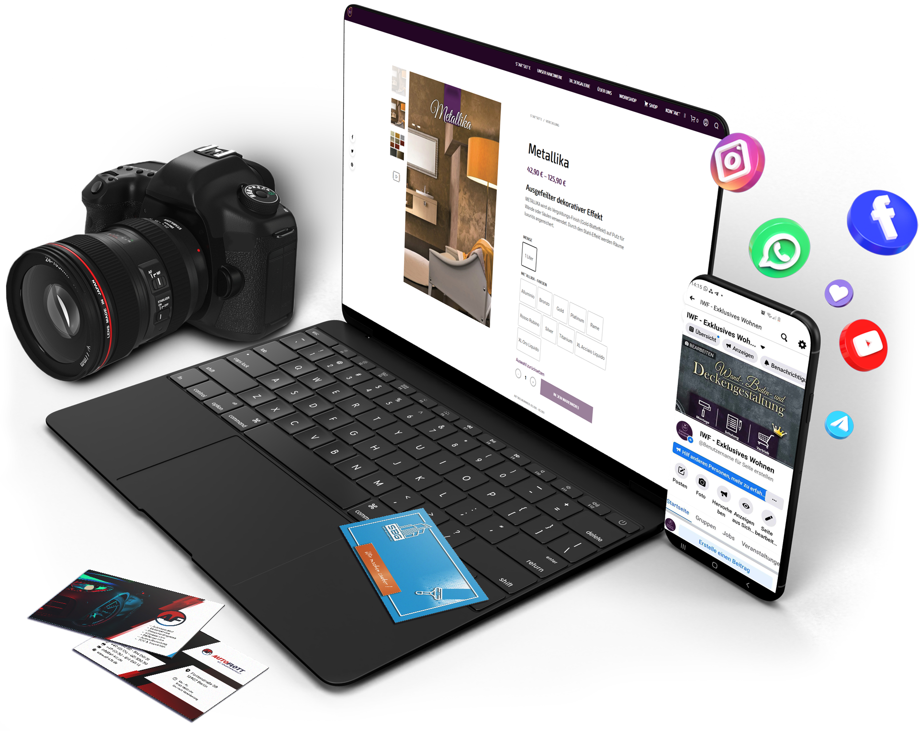
My Experience as an Intern_

Slide 2
Things to come…_
The Company.
My Role & Responsibilities.
Projects & Tasks.
Team Collaborations.
Technology & Tools Used.
Skills & Knowledge Gained.
Conclusion.
Q&A.

Slide 3

The Company.
1 What Pixelding does.
2 Pictures.
3 More pictures .

Slide 4








The Company.
1 What Pixelding does.

Slide 5

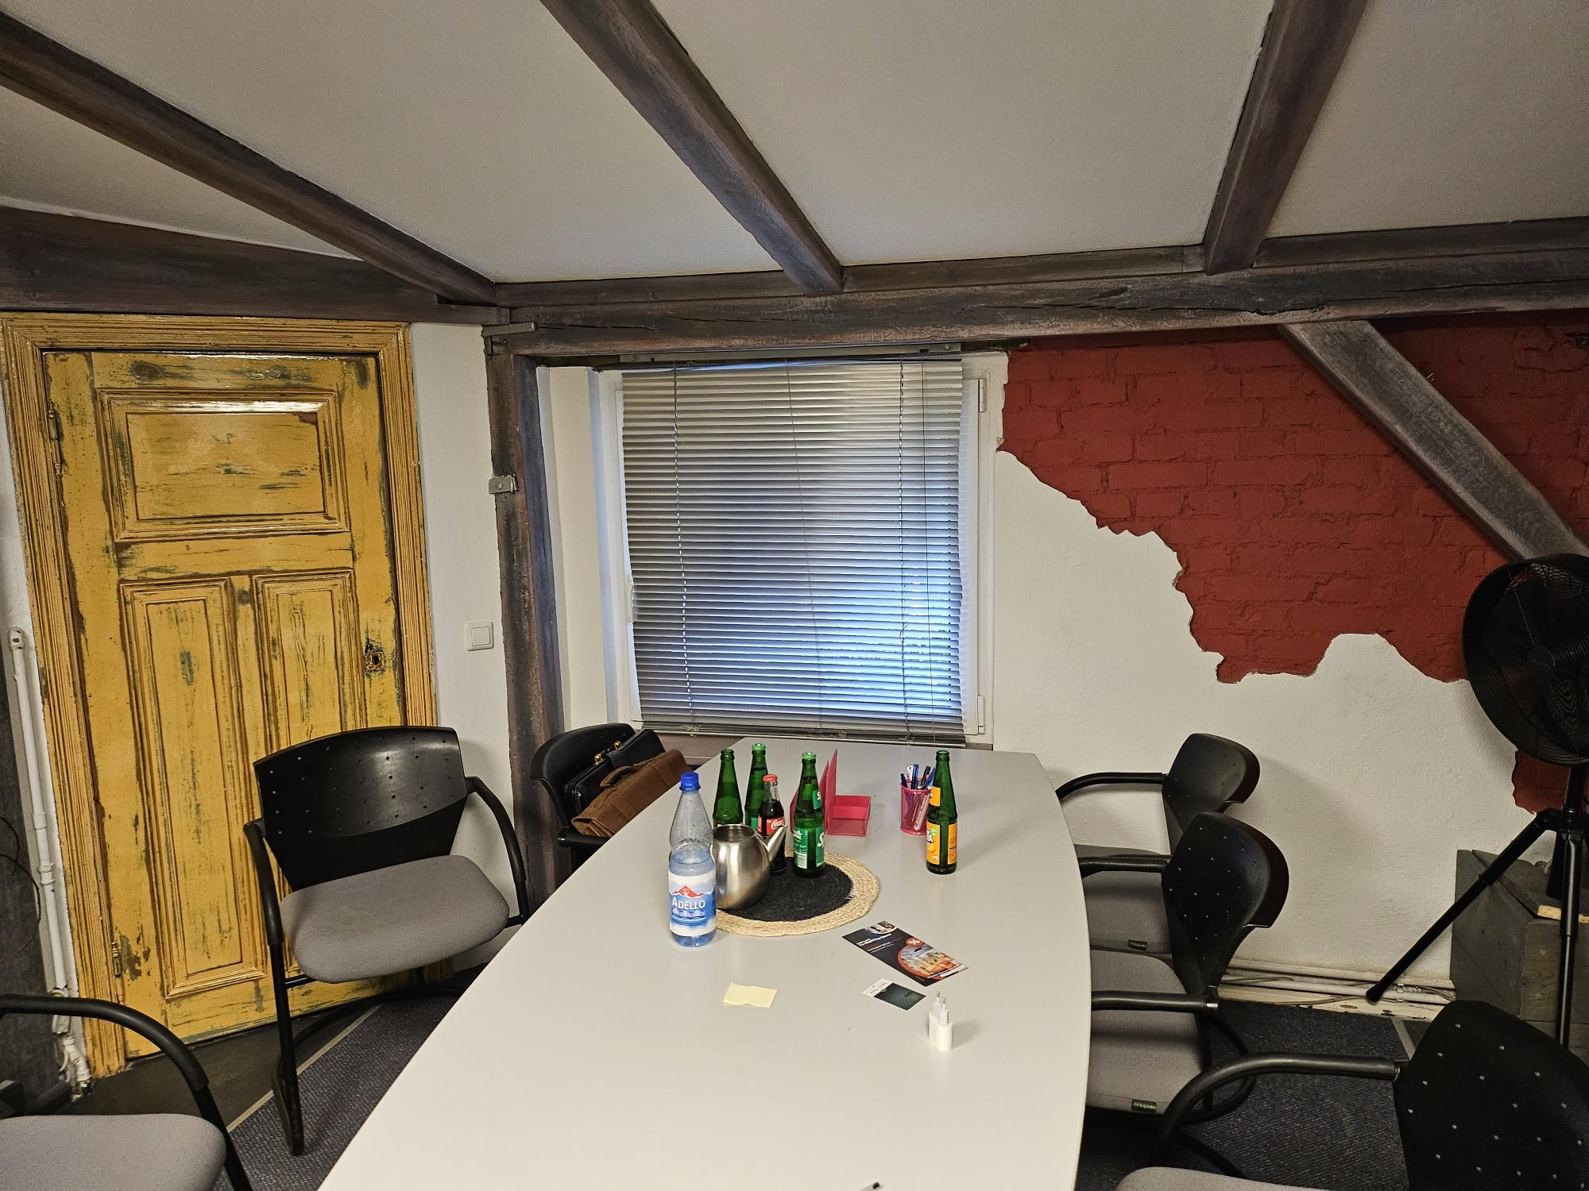
The Company.
2 Pictures.

Slide 6
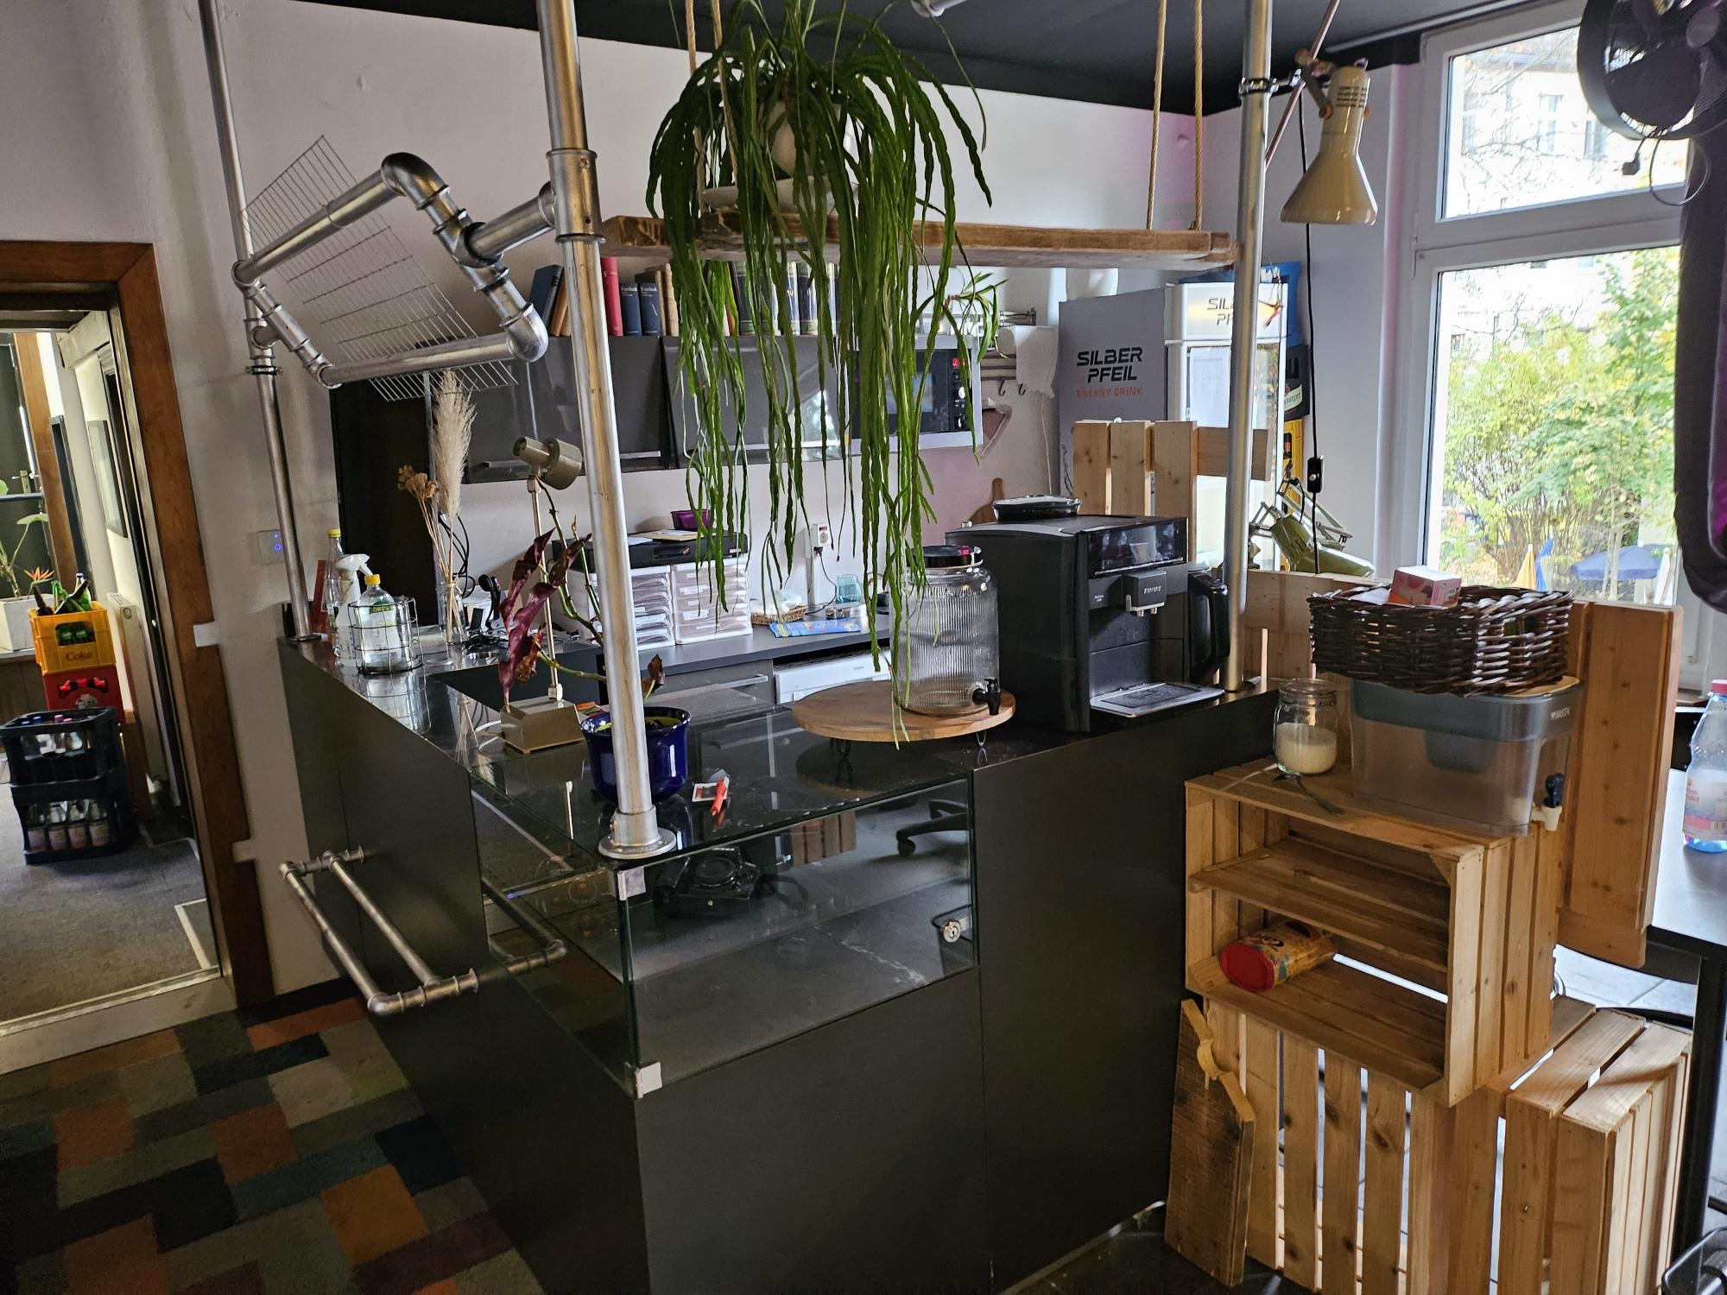

The Company.
3 More Pictures!!.

Slide 7
My Role & Responsibilities.
My position and department.
Specific responsibilities assigned to me.
- Programming.
- upload onto websites.
with FileZilla.

Slide 8

Projects and Tasks.
1 CBD Online Shop.
2 Putzmittel Online Shop.

Slide 9


Projects and Tasks.
1 CBD Online Shop.
- Email Benachrichtigung & AirTable update:.
on user registration or purchase.
With Zapier, and AirTable.

Slide 10





Projects and Tasks.
2 Putzmittel Online Shop.
- Download infos with Python.
- Upload infos with Woocommerce API.
as csv to WordPress.
+ add Plugins.

Slide 11


Team Collaborations.
Colleagues and team members.
Communication tools used within the company.
Collaborative projects or team achievements.

Slide 12

Technology and Tools Used.
1 Software, tools, I knew.
2 Software, tools, I discovered.

Slide 13











Technology and Tools Used.
1 Software, tools, I knew.
Collaboration & Communica-tion | Version Control & Code Collaboration | File Storage & Sharing | CMS | Database & Development | Web Hosting & Domain Management | FTP Client
Slack, WhatsApp, Ionos Email, Telefon | GitHub | Google Drive | WordPress WooCommerce | XAMPP Visual Studio Code (IDE) | Ionos | FileZilla

Slide 14




Technology and Tools Used.
2 Software, tools, I discovered.
Automation | Database Management | Project Management | Security
Zapier | AirTable | Asana | LastPass (Password Manager)

Slide 15
Skills and Knowledge Gained.
Skills acquired during the internship.
Knowledge gained and how it relates to my academic studies .
Training or workshops .
Challenges faced (and how you overcame them).
Personal and professional growth during the internship.
Any unexpected insights or lessons.

Slide 16
Conclusion.
Summary of key points.
Express gratitude to the company and colleagues .
Any future plans or reflections .
affects on the team or the company .
Quantifiable results, if applicable…._
Positive feedback or recognition received .

Slide 17

Q&A.

